Slide 1
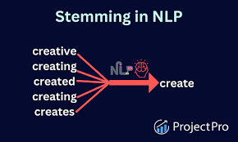
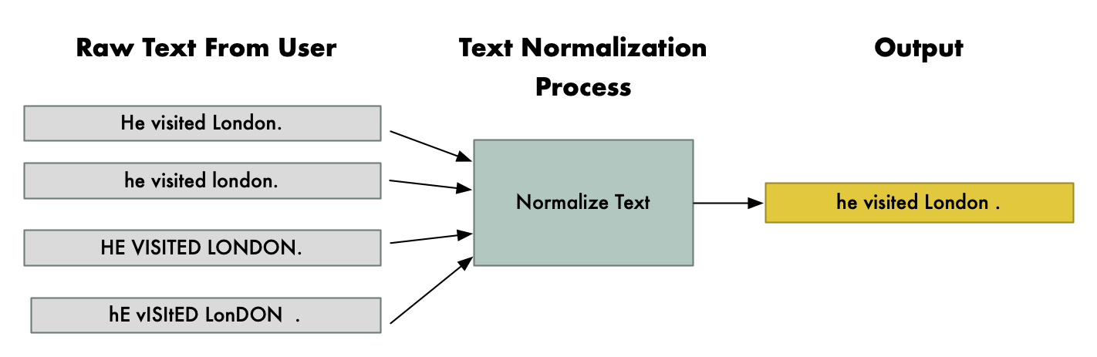
LECTURE 3
Word Normalization and Stemming
Notes:
Hello Everyone. Lecture 3 which covers the Word Normalization and Stemming

Slide 2
Normalization
Need to “normalize” terms
InformaGon Retrieval: indexed text & query terms must have same form.
We want to match U.S.A. and USA
We implicitly deﬁne equivalence classes of terms
e.g., deleGng periods in a term
AlternaGve: asymmetric expansion:
Enter: window
Enter: windows
Enter: Windows
Search: window, windows
Search: Windows, windows, window
Search: Windows
Potentially more powerful, but less eﬃcient
Notes:
What is Normalization? Normalization, in the context of information retrieval or databases, refers to the process of organizing and structuring data to eliminate redundancy and improve consistency. It ensures that data is stored and processed in a standardized way, making it easier to search, retrieve, and manage.
Normalization in Information Retrieval (IR) is essential to ensure that both indexed text and query terms share the same form for accurate matching.
This process allows terms like "U.S.A." and "USA" to be matched by implicitly defining equivalence classes of terms, such as removing periods from terms.
In the context of information retrieval, the concept of "normalization" emphasizes the importance of ensuring that indexed text and query terms maintain a consistent form for effective matching.
Example: consider the terms "window," "windows," and "Windows." When entering these terms, they should be treated uniformly to facilitate accurate retrieval. Subsequently, during searches, variations such as "window" and "Windows" should yield relevant results.
This approach streamlines the retrieval process by accounting for different forms of terms while maintaining consistency and precision.

Slide 3
Case folding
Applications like IR: reduce all letters to lower case
Since users tend to use lower case
Possible exception: upper case in mid-­‐sentence?
e.g., General Motors
Fed vs. fed
SAIL vs. sail
For sentiment analysis, MT, Information extraction
Case is helpful (US versus us is important)
Notes:
Normalization in applications like Information Retrieval (IR) involves converting all letters to lowercase, aligning with users' tendency to input queries in this format.
However, exceptions may arise, such as maintaining uppercase letters within sentences, as seen in "General Motors.
eg: "Fed" (which can refer to the Federal Reserve System) and "fed" (the past tense of "to feed"),
"SAIL" (Steel Authority of India Limited) and "sail" (the verb).
capitalization differences carry distinct meanings. Maintaining this distinction ensures accurate interpretation and processing, especially in contexts such as entity recognition, sentiment analysis, and language translation tasks.
The consideration of case is crucial for tasks like sentiment analysis, machine translation (MT), and information extraction, where the differentiation between "US" (United States) and "us" is significant.

Slide 4
Lemmatization
Reduce inﬂections or variant forms to base form
am, are, is → be
car, cars, car's, cars' → car
the boy's cars are diﬀerent colors → the boy car be diﬀerent color
Lemmatization: have to ﬁnd correct dictionary headword form
Machine translation
Spanish quiero (‘I want’), quieres (‘you want’) same lemma as querer ‘want’
Notes:
What is Lemmatization:
Lemmatization is a linguistic process used in natural language processing (NLP) to reduce words to their base form, known as a lemma. The purpose of lemmatization is to normalize words so that different inflected forms of the same word are treated as the same word.
Example: verbs like "am," "are," and "is" are transformed into "be,"
while nouns like "car," "cars," "car's," and "cars'" are all simplified to "car.”
In NLP tasks like text analysis, sentiment analysis, or information retrieval, lemmatization is often used to improve the accuracy of algorithms by reducing the dimensionality of the feature space and ensuring that words with similar meanings are treated identically.
Use Case: Machine Translation:
In practice, this process helps streamline text analysis and machine translation tasks. The above machine translation approach ensures consistency and accuracy in language processing tasks by handling variant forms uniformly.

Slide 5
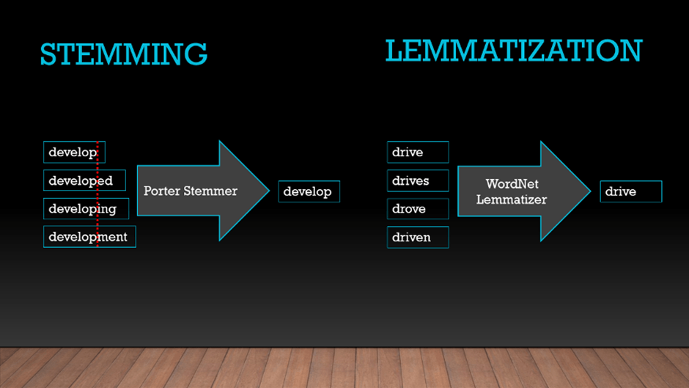
Notes:
This post-stemming process simplifies word forms to their common root, aiding in text analysis tasks such as clustering or classification. All words are reduced to their base form.
This WordNet Lemmatization method ensures that different inflections of a word are unified, facilitating more accurate semantic analysis and natural language processing tasks.

Slide 6

Morphology
Morphemes:
The small meaningful units that make up words
Stems: The core meaning-­‐bearing units
Aﬃxes: Bits and pieces that adhere to stems
Oden with grammatical functions
Notes:
Morphemes: Morphemes are the smallest units of meaning in a language. They can be individual words or parts of words, such as prefixes, suffixes, or roots. Morphemes can't be broken down further into smaller meaningful units. For example, in the word "unhappiness," "un-" and "-ness" are morphemes.
Stems: In linguistics, a stem is the core or base part of a word to which affixes can be added. It's the part of the word that carries the primary meaning. For example, in the word "unhappiness," "happi-" is the stem. Stems can be standalone words or roots, and they are often modified by affixes to create new words or inflected forms.
Affixes: Affixes are morphemes that are added to the beginning (prefixes) or end (suffixes) of a stem or root to modify its meaning or grammatical function. They can change the tense, number, case, or part of speech of a word. For example, in the word "dislike," "dis-" is a prefix, and "-like" is a suffix.

Slide 7
Stemming
Reduce terms to their stems in information retrieval
Stemming is crude chopping of aﬃxes
language dependent
e.g., automate(s), automatic, automation all reduced to automat.
for example compressed and compression are both accepted as equivalent to compress.
for exampl compress and compress ar both accept as equival to compress
Notes:
What is Stemming:
Stemming is a linguistic process used in natural language processing (NLP) to reduce words to their root or stem form by removing suffixes or prefixes. The goal of stemming is to transform words into their base or root form so that variations of the same word are treated as the same word.
Example: Words like "automate(s)," "automatic," and "automation" are all reduced to the common stem "automat."

Slide 8
Porter’s algorithm
The most common English stemmer
Step 1a
sses → ss ies → i
ss → ss
s → ø
Step 1b
Step 2 (for long stems)
caresses ponies caress cats
→ caress
→ poni
→ caress
ational→ ate relational→ relate
izer→ ize | digitizer | → | digitize
ator→ ate | operator | → | operate
…
→ cat
Step 3 (for longer stems)
(*v*)ing | → | ø | walking | → | walk
(*v*)ed | → | ø | sing plastered | → → | sing plaster
…
al | → ø | revival | → | reviv
able | → ø | adjustable | → | adjust
ate … | → ø | activate | → | activ
Notes:
The goal of Porter's algorithm is to reduce words to their stems by systematically applying a series of rules to remove suffixes. These rules are based on linguistic heuristics rather than strict linguistic rules, making the algorithm relatively simple and efficient. Porter's algorithm aims to produce stems that are linguistically meaningful, although it may sometimes generate stems that are not actual words.
eg: we have the word "running" and we want to find its stem using Porter's algorithm.
Step 1 - Apply Rules: Porter's algorithm applies a series of rules to remove suffixes. One of the rules for removing suffixes is to remove "-ing" if the stem has a vowel before the "ing". So, "running" becomes "runn".
Step 2 - Further Modifications: After applying the main rule, there might be additional modifications. In this case, the algorithm checks if the resulting word ends with a double consonant, and if it does, it removes one of the consonants. So, "runn" becomes "run".
The resulting stem using Porter's algorithm for the word "running" is "run".

Slide 9
Viewing morphology in a corpus
Why only strip –ing if there is a vowel?
(*v*)ing → ø
walking | → | walk
sing | → | sing
Notes:
Avoiding Over-stemming: Words ending in "-ing" are often present participle forms of verbs. Removing "-ing" indiscriminately without considering whether there's a vowel before it could lead to over-stemming. For example, consider the word "sing." If we remove "-ing" without considering the preceding vowel, we would get "s," which is not the stem of the word "sing." By restricting the removal to cases where there's a vowel before "-ing," we avoid such over-stemming.
Preserving Meaningful Stems: Words like "swing," "ring," or "bring" contain "-ing" as part of their stem rather than as a suffix denoting a verb form. By restricting the removal of "-ing" to cases where there's a preceding vowel, we preserve meaningful stems in such words.
Reducing Errors: Applying this rule helps in reducing errors in stemming by ensuring that only suffixes that are more likely to indicate a verb form are removed. This increases the accuracy of stemming, which is crucial for tasks like text processing and information retrieval.

Slide 10
Viewing morphology in a corpus
Why only strip –ing if there is a vowel?
(*v*)ing → ø
walking sing
→ walk
→ sing
tr | -sc | 'A-Za-z' | '\n' | < shakes.txt | | | grep | ’ing$' | | sort | | | uniq | -c | | | sort | –nr
 |  |  | 1312 | King |  | 548 | being
 |  |  | 548 | being |  | 541 | nothing
 |  |  | 541 | nothing |  | 152 | something
 |  |  | 388 | king |  | 145 | coming
 |  |  | 375 | bring |  | 130 | morning
 |  |  | 358 | thing |  | 122 | having
 |  |  | 307 | ring |  | 120 | living
 |  |  | 152 | something |  | 117 | loving
 |  |  | 145 | coming |  | 116 | Being
 |  |  | 130 | morning |  | 102 | going
tr -sc 'A-Za-z' '\n' < shakes.txt | grep '[aeiou].*ing$' | sort | uniq -c | sort –nr
37
Notes:
tr -99 'A-Za-z' '\n' < shakes.txt: This command is replacing non-alphabetic characters with newline characters in "shakes.txt".
grep 'laeiou).*ings: This command filters out words ending in "-ings" with a vowel before the "-ing" suffix.
sort: This command sorts the filtered list of words alphabetically.
uniq -c: This command counts the unique occurrences of each word in the sorted list.
sort -nr: This command sorts the counted occurrences in descending order, showing the most frequent words first.
These commands that are likely being used to analyze text data, particularly focusing on words ending in "-ings" in the file "shakes.txt," which presumably contains text from Shakespeare's works.
The output shows the frequency counts of words ending in "-ings" with a vowel before the suffix "-ing" in the "shakes.txt" file.

Slide 11
Dealing with complex morphology is sometimes necessary
Some languages requires complex morpheme segmentation
Turkish
UygarlasGramadiklarimizdanmissinizcasina
`(behaving) as if you are among those whom we could not civilize’
Uygar `civilized’ + las `become’
+ Gr `cause’ + ama `not able’
+ dik `past’ + lar ‘plural’
+ imiz ‘p1pl’ + dan ‘abl’
+ mis ‘past’ + siniz ‘2pl’ + casina ‘as if’
Notes:
Complex morphology often involves employing sophisticated linguistic techniques such as lemmatization, stemming, morphological parsing, and part-of-speech tagging. These techniques help in reducing word variation, identifying word forms, and capturing linguistic nuances, ultimately enhancing the performance of natural language processing systems.

Slide 12
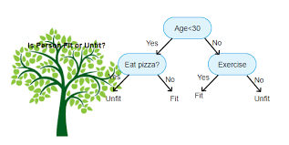
Sentence Segmentation and Decision Trees
Notes:
Sentence segmentation refers to the process of identifying and splitting text into individual sentences. It is a fundamental task in natural language processing (NLP) and text analysis, as many downstream NLP tasks rely on sentence-level processing.
One approach to sentence segmentation involves using decision trees. Decision trees are a type of supervised machine learning algorithm used for classification and regression tasks. In the context of sentence segmentation, decision trees can be trained to classify whether a given punctuation mark (such as a period, question mark, or exclamation mark) indicates the end of a sentence or not.

Slide 13
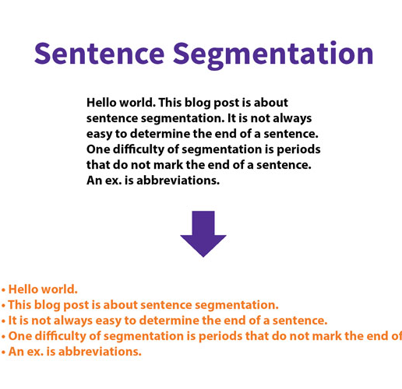
What is Sentence Segmentation?
This skill is moving from a whole sentence to segmenting words in a sentence.
This can be a tough skill as students may find it difficult to recognize certain words as a whole word instead they may put two words together and identify it as one word.

Slide 14
Sentence Segmentation
!, ? are relatively unambiguous
Period “.” is quite ambiguous
Sentence boundary
AbbreviaGons like Inc. or Dr.
Numbers like .02% or 4.3
Build a binary classiﬁer
Looks at a “.”
Decides EndOfSentence/NotEndOfSentence
Classiﬁers: hand-­‐wri@en rules, regular expressions, or machine-­‐learning
Notes:
Common approaches to sentence segmentation:
Punctuation-Based Segmentation: This approach relies on the presence of punctuation marks such as periods, question marks, and exclamation marks to identify sentence boundaries. Text is split into sentences wherever these punctuation marks occur, with some additional rules to handle abbreviations, ellipses, and other punctuation marks.
Rule-Based Segmentation: Rule-based methods use predefined rules or patterns to identify sentence boundaries. These rules may consider punctuation marks, capitalization, quotation marks, and other linguistic cues to determine sentence boundaries. Rule-based approaches can be language-specific and may require manual crafting of rules.
Machine Learning-Based Segmentation: Machine learning techniques, including supervised and unsupervised methods, can be employed for sentence segmentation. Supervised methods use labeled data to train models to predict sentence boundaries based on features extracted from the text. Unsupervised methods typically rely on statistical measures, such as sentence length, punctuation frequency, and word distribution, to segment text without labeled data.
Hybrid Approaches: Hybrid approaches combine multiple methods to improve segmentation accuracy. For example, a system may first use punctuation-based segmentation and then apply machine learning models to refine the segmentation boundaries based on contextual information.
Language-Specific Techniques: Sentence segmentation may vary across languages due to differences in punctuation usage, word order, and grammatical structure. Language-specific techniques account for these variations to achieve accurate segmentation for different languages.

Slide 15

What are decision trees?
A decision tree is a decision support hierarchical model that uses a tree-like model of decisions and their possible consequences, including chance event outcomes, resource costs, and utility.
It is one way to display an algorithm that only contains conditional control statements.
Notes:
What are decision trees?
Decision trees are a type of supervised machine learning algorithm used for both classification and regression tasks. They are powerful and interpretable models that learn simple decision rules from the data to make predictions.
Here's how decision trees work:
Tree Structure: A decision tree is composed of nodes, branches, and leaves. Each internal node represents a decision based on a feature, and each branch represents the outcome of that decision. The leaves of the tree represent the final decision or prediction.
Splitting Criteria: At each internal node, the decision tree algorithm selects the feature and the threshold that best splits the data into homogeneous subsets. The goal is to maximize the purity or homogeneity of the subsets, typically measured by metrics like Gini impurity or information gain.
Recursive Partitioning: The process of splitting the data based on the selected features and thresholds is recursively applied to each subset until certain stopping criteria are met. These criteria could include a maximum tree depth, a minimum number of samples in each leaf node, or a minimum improvement in purity with each split.
Prediction: Once the tree is built, making predictions for new instances involves traversing the tree from the root node down to a leaf node based on the features of the instance. The prediction at the leaf node is then used as the final output.

Slide 16
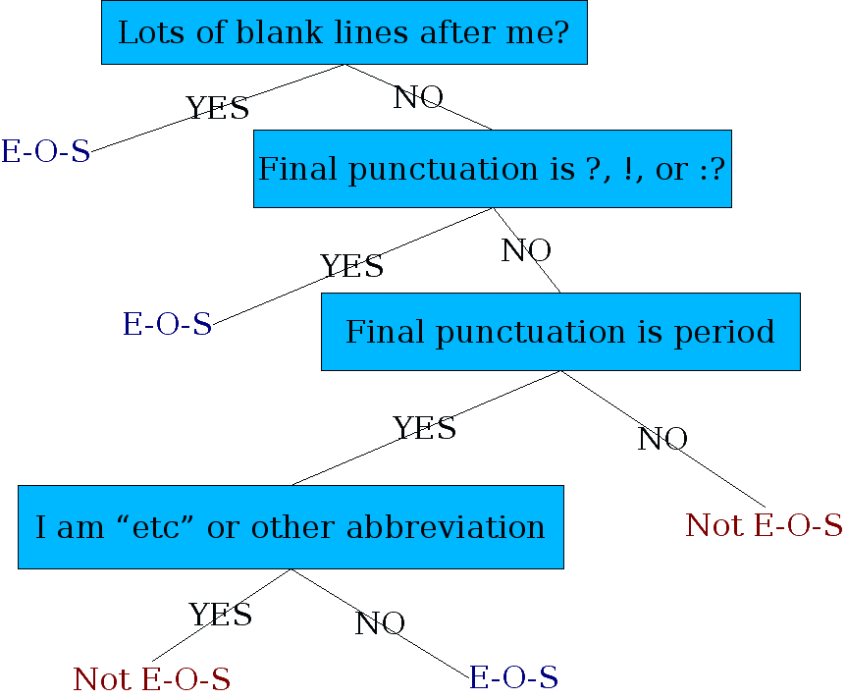
Determining if a word is end-­‐of-­‐sentence: a Decision Tree
Notes:
Creating a decision tree to determine if a word signifies the end of a sentence involves establishing criteria based on linguistic patterns. Here's a simplified example of how a decision tree might be constructed for this purpose:
Feature Selection:
Consider features such as punctuation, context, and the nature of the word itself.
Example Decision Tree:
Root Node: Punctuation Check
If the word ends with an exclamation mark or a question mark, classify as End-Of-Sentence.
If not, proceed to the next decision node.
Decision Node: Period Check
If the word ends with a period, check for additional context.
If the word is part of an abbreviation (e.g., "Inc."), classify as Not End-Of-Sentence.
If the word is a number (e.g., "4.3"), classify as Not End-Of-Sentence.
If none of the above, classify as End-Of-Sentence.
End Result:
The decision tree, when applied to a word, will guide the classification process based on the defined criteria. For example, "Hello!" would be classified as End-Of-Sentence in the first step, while "Dr." would be classified as Not End-Of-Sentence in the second step.

Slide 17
More sophisticated decision tree features
Case of word with “.”: Upper, Lower, Cap, Number
Case of word ader “.”: Upper, Lower, Cap, Number
Numeric features
Length of word with “.”
Probability(word with “.” occurs at end-­‐of-­‐s)
Probability(word ader “.” occurs at beginning-­‐of-­‐s)
Notes:
A sophisticated decision tree for end-of-sentence determination incorporates features such as the case of words with periods, numeric characteristics, word lengths, and probabilities. These features allow the tree to make nuanced decisions based on the diverse linguistic patterns associated with periods in words. This approach enhances the accuracy of sentence boundary classification, making it more adaptable to various contexts and linguistic complexities.
Case of word with ".": This feature refers to the case (capitalization) of the word containing a period. The possible cases are:
Upper: The word is in all uppercase letters (e.g., "WORD.")
Lower: The word is in all lowercase letters (e.g., "word.")
Cap: The word starts with an uppercase letter and is followed by lowercase letters (e.g., "Word.")
Number: The word consists entirely of numeric characters (e.g., "1234.").
Case of word after ".": This feature refers to the case of the word immediately following the period. It has the same possible cases as the first feature (Upper, Lower, Cap, Number).
Numeric features: These features pertain to numeric characteristics of the word containing a period:
Length of word with ".": This feature represents the number of characters in the word containing a period.
Probability(word with "." occurs at end-of-s): This feature indicates the probability of the word containing a period occurring at the end of a sentence.
Probability(word after "." occurs at beginning-of-s): This feature indicates the probability of the word immediately following the period occurring at the beginning of a sentence.

Slide 18

Implementing Decision Trees
A decision tree is just an if-­‐then-­‐else statement
The interesting research is choosing the features
SeSng up the structure is oden too hard to do by hand
Hand-­‐building only possible for very simple features, domains
For numeric features, it’s too hard to pick each threshold
Instead, structure usually learned by machine learning from a training corpus
Notes:
while decision trees can be conceptualized as simple if-then-else statements, the real power lies in leveraging machine learning to automatically learn the structure based on relevant features and patterns in the data. This approach enhances the adaptability and effectiveness of decision trees in handling complex decision-making scenarios.
Indeed, decision trees can be conceptualized as a series of if-then-else statements, where each internal node represents a decision based on a feature, and each branch represents the outcome of that decision. This simplicity and interpretability make decision trees attractive models for various machine learning tasks.

Slide 19
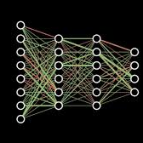
Decision Trees and other classiﬁers
We can think of the questions in a decision tree
As features that could be exploited by any kind of classiﬁer
Logistic regression
SVM
Neural Nets
etc.
Notes:
Decision trees are a type of supervised learning algorithm used for both classification and regression tasks. They work by partitioning the feature space into smaller regions, each associated with a specific class label or predicted value. While decision trees have their advantages, such as interpretability and ease of understanding, they may not always be the best choice for every problem.
Random Forests:
Random forests are an ensemble learning technique that builds multiple decision trees and combines their predictions to improve accuracy and robustness.
They mitigate the issue of overfitting inherent in single decision trees by aggregating predictions from multiple trees.
Random forests are suitable for high-dimensional data and can handle large datasets efficiently.
Support Vector Machines (SVM):
SVM is a powerful supervised learning algorithm used for classification and regression tasks.
It works by finding the hyperplane that best separates different classes in the feature space.
SVM is effective in high-dimensional spaces and can handle non-linear decision boundaries through the use of kernel functions.
However, SVMs may be less interpretable compared to decision trees.
Logistic Regression:
Logistic regression is a simple yet effective classification algorithm that models the probability of the outcome as a function of the predictor variables.
It's well-suited for binary classification tasks and provides interpretable coefficients that indicate the strength and direction of the relationships between features and the target variable.
Logistic regression assumes a linear relationship between features and the log-odds of the outcome.
Neural Networks:
Neural networks are powerful machine learning models inspired by the structure and function of the human brain.
They can learn complex patterns and relationships in data through multiple layers of interconnected neurons.
Neural networks excel at tasks involving unstructured data such as images, text, and speech recognition, but they may require large amounts of data and computational resources for training.
Naive Bayes:
Naive Bayes is a probabilistic classifier based on Bayes' theorem with an assumption of independence between features.
It's simple, efficient, and works well with high-dimensional data.
Naive Bayes is particularly suited for text classification tasks, such as spam detection and document categorization.

Slide 20

Notes:
Thank you

